Slide 1

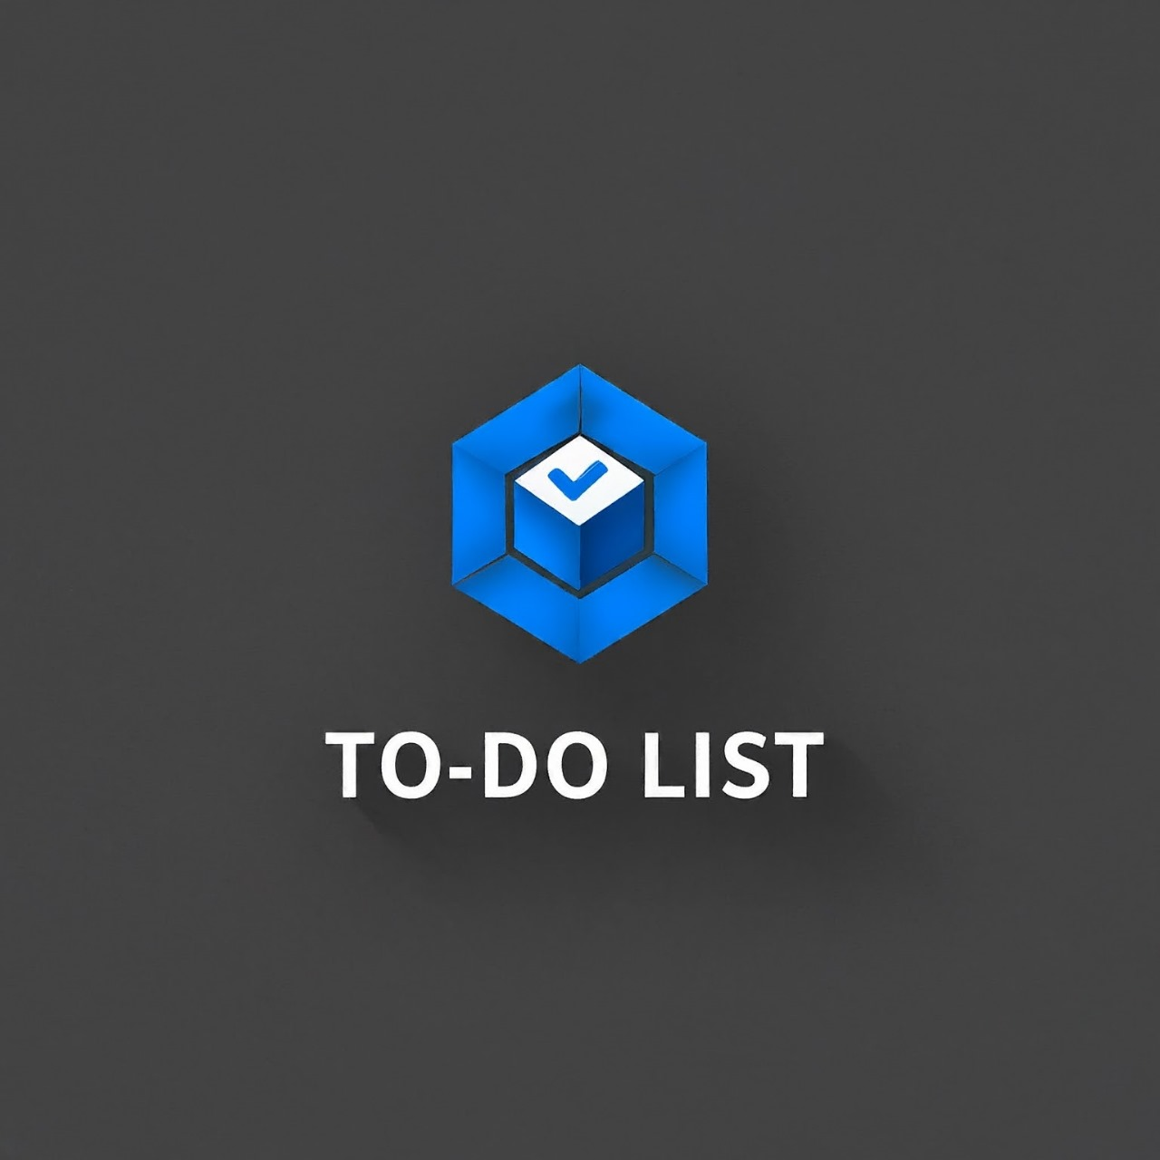

MIND BLOCK
Team members:
M. Shriya Sri
Sanika V. H.
Joyce Arpana
Arpitha A.
Gagana K.
To-Do List using blockchain

Slide 2

TO-DO LIST
PROBLEM STATEMENT:
To build a to do list app where tasks are stored on the Blockchain and each task is associated with a token and users can earn rewards in crypto.

Slide 3
SOLUTION:
-Many existing to-do list apps lack innovation.
Users often need more motivation to complete tasks.
-Traditional task management systems do not utilize the potential of blockchain technology.
Goal: To create a decentralized to-do list app where tasks are stored on the blockchain, and users are rewarded with Diam tokens.

Slide 4
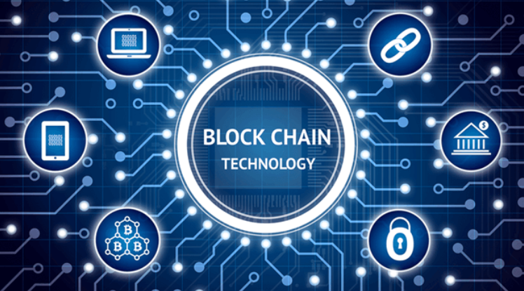
WHY BLOCKCHAIN IN TO-DO LIST:
Transparency: Every task is verifiable on the blockchain.
Immutability: Tasks and records of their completion cannot be altered.
Decentralization: No single entity controls the data; it is distributed.
Incentivization: Users can earn cryptocurrency( DIAM’s)rewards for completing tasks.

Slide 5

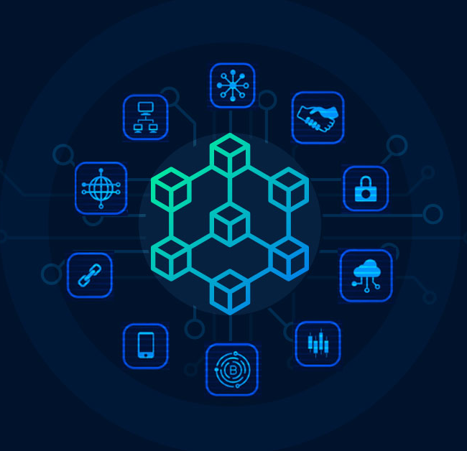
APP FEATURES:
Task Creation: Users create tasks that are stored on the blockchain.
Token Association: Each task is associated with a unique token.
Reward System: Users earn cryptocurrency rewards upon task completion.
User Profile: Track user progress, completed tasks, and earned rewards.
Smart Contracts: Automated reward distribution using smart contracts.

Slide 6

WORKFLOW OF THE APP :
Step 1: User creates a task in the app.
1
Step 2: The task is stored on the blockchain and a token is issued.
2
Step 3: User completes the task and marks it as done.
3
Step 4: Smart contract verifies completion and releases the reward.
4
Step 5: User receives cryptocurrency in their wallet.

Slide 7

Benefits to Users
1)Monetary Rewards: Earn cryptocurrency for completing tasks
2)Enhanced Motivation: Financial incentives to boost productivity.
3)Ownership: Users have control over their tasks and rewards.
4)Trust and Security: Immutable records ensure fair reward distribution.

Slide 8
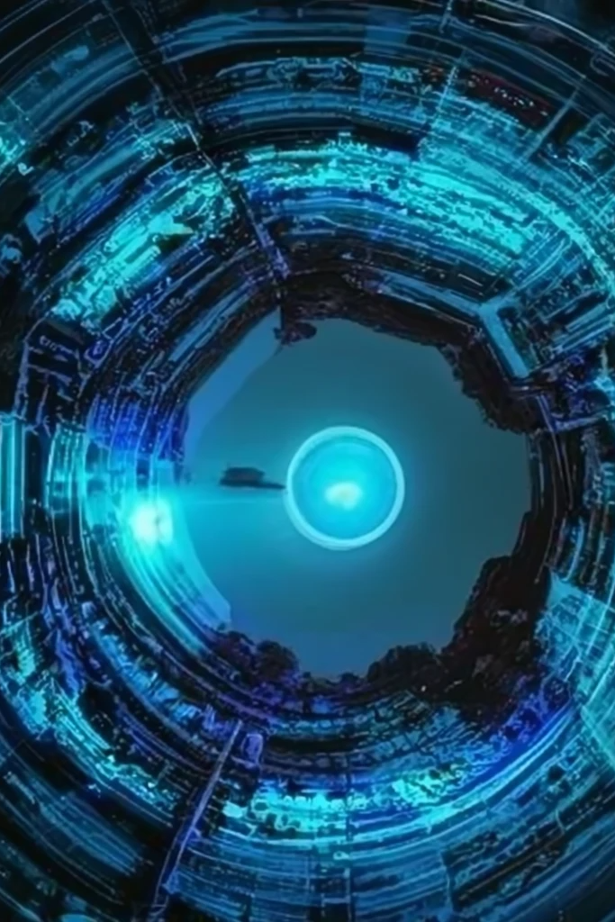
Future Enhancements:
Integration with DeFi : Allow users to invest their rewards directly into DeFi projects.
Cross-Platform Compatibility : Make the app available on multiple platforms.
Community Features : Enable task sharing and collaboration.
Advanced Analytics : Provide insights on productivity and reward patterns.

Slide 9
THANK YOU !!

